Slide 1

银行管理系统
3班6组
石子齐（菜单部分）
代宇盛（查询取款部分）
马筱蕾（存款与转账部分）
杨菲 （登录与验证部分）
张容川（密码找回部分）
赵嘉晨（信息注册部分）

Slide 2
项目需求分析
实现有图形化界面的银行信息管理系统（包括注册、存款、取款、转账、查询、找回密码等）

Slide 3
任 务
1.菜单 5.验证
2.登录 6.存取款
3.开户与挂失 7.用户信息读写
4.查询

Slide 4
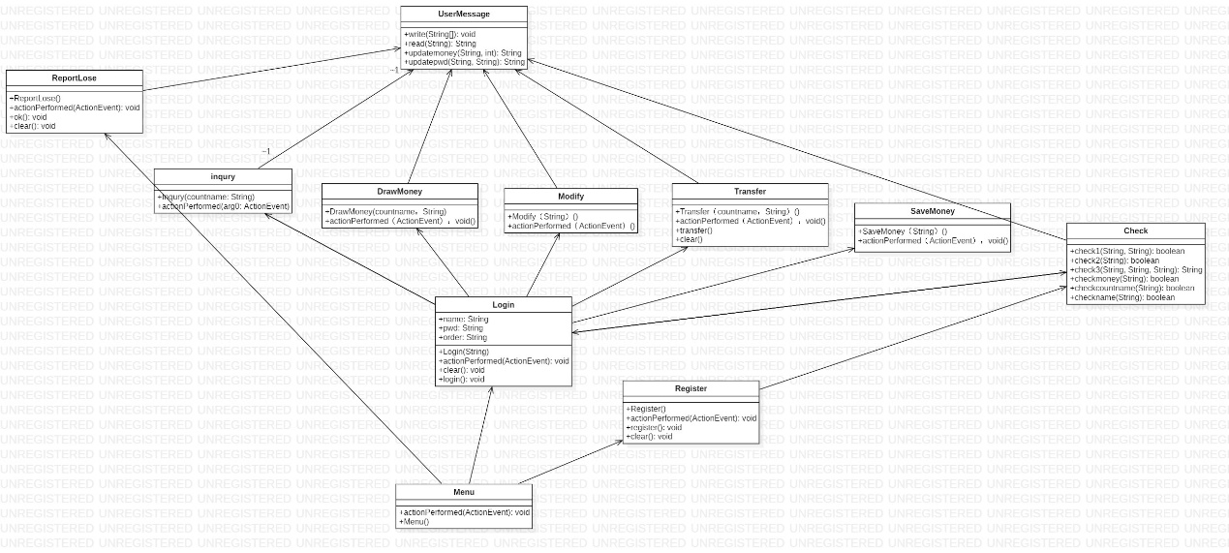
UML类图

Slide 5
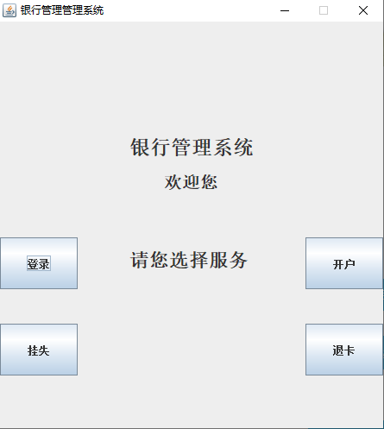
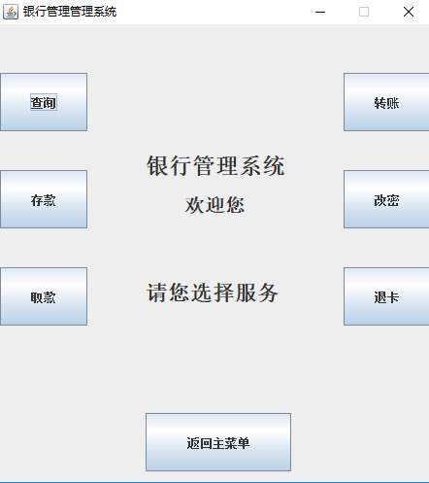
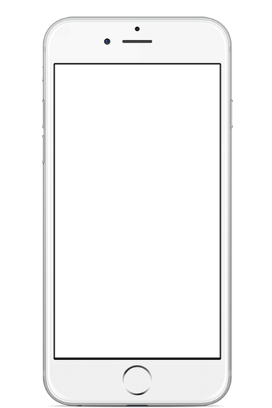
界面
输入账户密码登陆成功之后，将会有登录界面跳转至功能选择菜单。
75%
69%
Everyone has their own dreams, I am the same.
Everyone has their own dreams, I am the same.

Slide 6
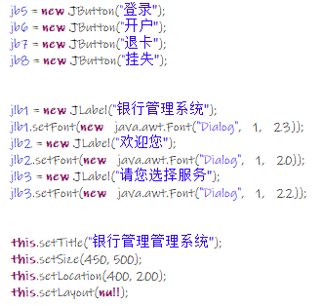
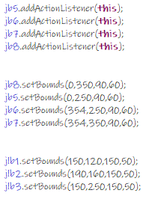
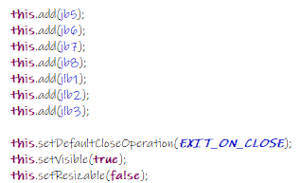
菜单
登录界面
SHURUBIAOTI
SHURUBIAOTI
Everyone has their own dreams, I am the same.
Everyone has their own dreams, I am the same.
Everyone has their own dreams, I am the same.
Everyone has their own dreams, I am the same.
Everyone has their own dreams, I am the same.

Slide 7
用户注册

Slide 8
Contents
01.设计图形化界面
02.判断用户填写的注册信息是否合法
03.重置账户

Slide 9
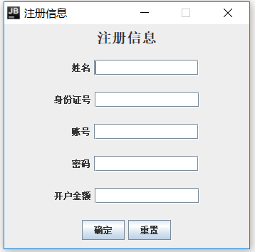
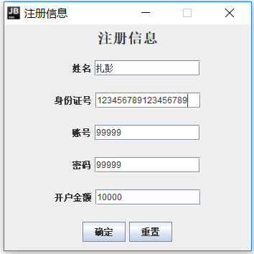
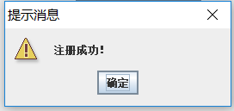
示例1

Slide 10
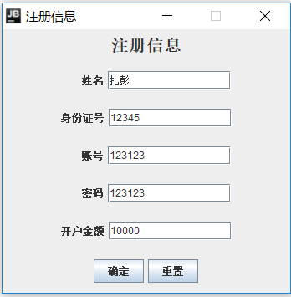
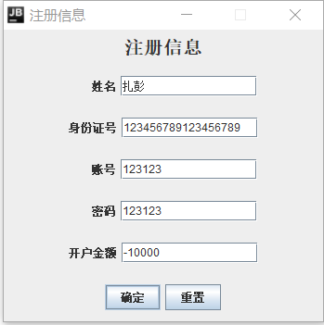
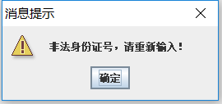
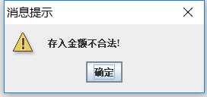
示例2

Slide 11
PART01 图形化界面的设计

Slide 12
PART02 验证并处理注册信息

Slide 13
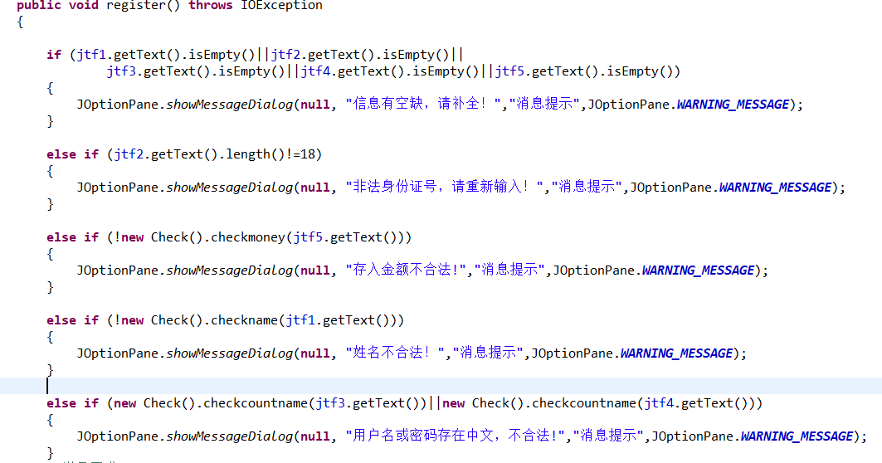
验证用户所输入的信息
验证用户所填信息是否有空缺
验证身份证号是否满18位
存款金额要非负
姓名中不能带数字等非法字符
用户名和密码中不能出现中文

Slide 14
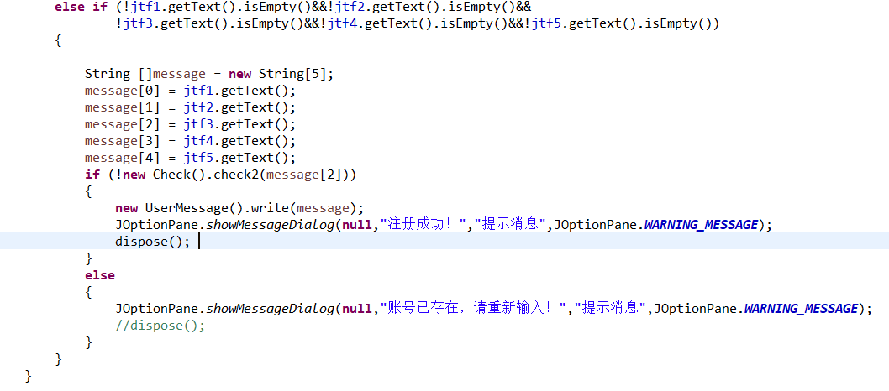
对用户输入的信息进行处理

Slide 15
PART03 清空

Slide 16
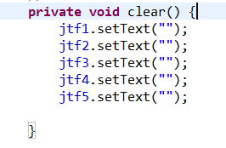
清空账号和密码框

Slide 17
用户登录

Slide 18

功能介绍
01. 读取用户输入的账号密码
03.与数据库进行验证
02. 对账号密码进行过滤
04.Enter title

Slide 19
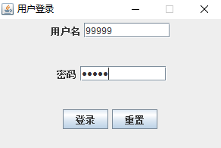
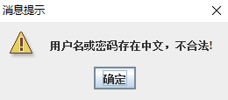
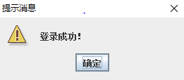
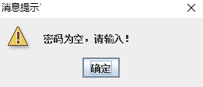
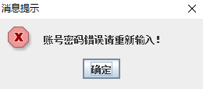
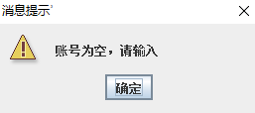
登录
1.读入用户名密码
2.输入信息过滤
3.验证

Slide 20
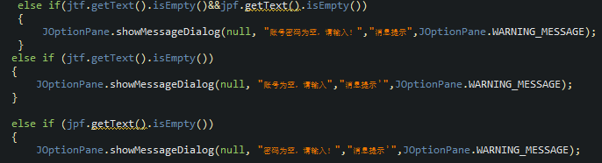
登录、过滤
2.顺序问题：
（第一个判断不是多余的）
Everyone has their own dreams, I am the same. But my dream is not a lawyer, not a doctor, not actors, not even an industry.
TITLE
TITLE
TITLE
1.面向对象（把所有的的check全部打包放在check类当中）

Slide 21
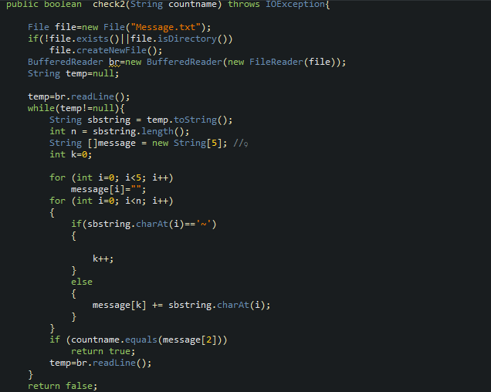
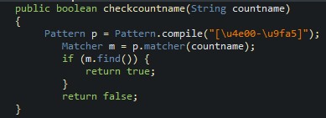
check
Eg2：文件中验证账户号和账户：
Eg1：
判断是否为中文字

Slide 22
WORKING
PLAN
查询，取款

Slide 23

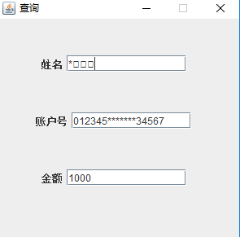
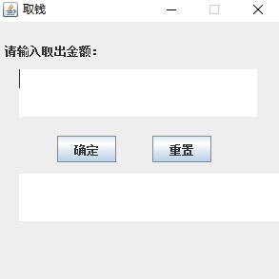
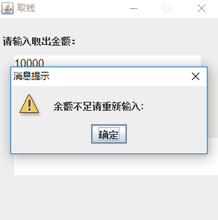
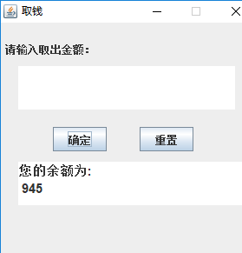
示例：
注：保密遮挡

Slide 24
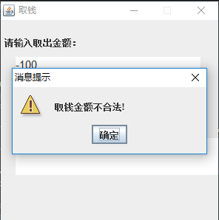
TITLE

Slide 25
存款，转账

Slide 26
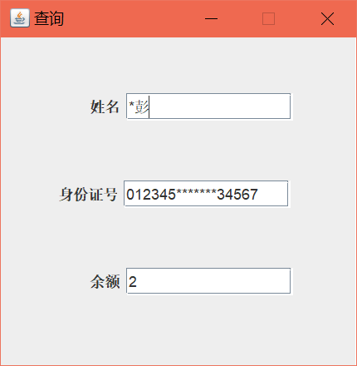
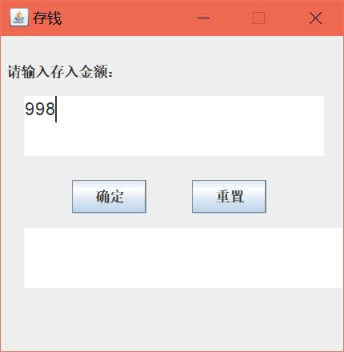
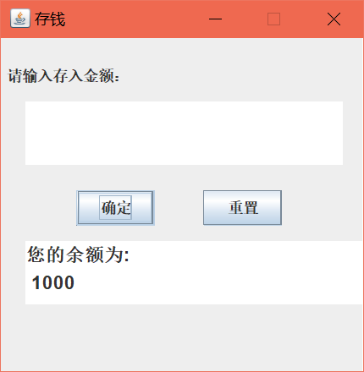
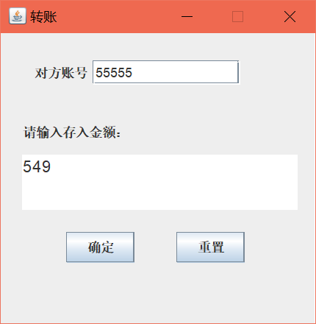
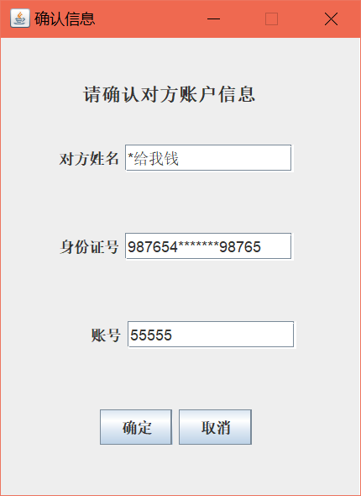
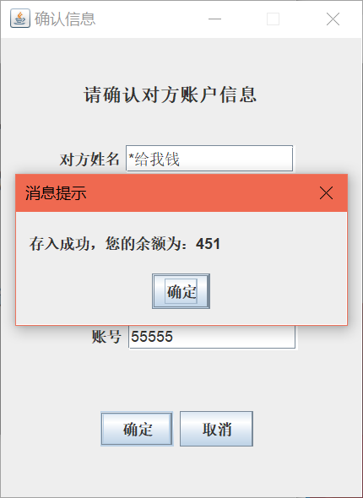
示例：

Slide 27
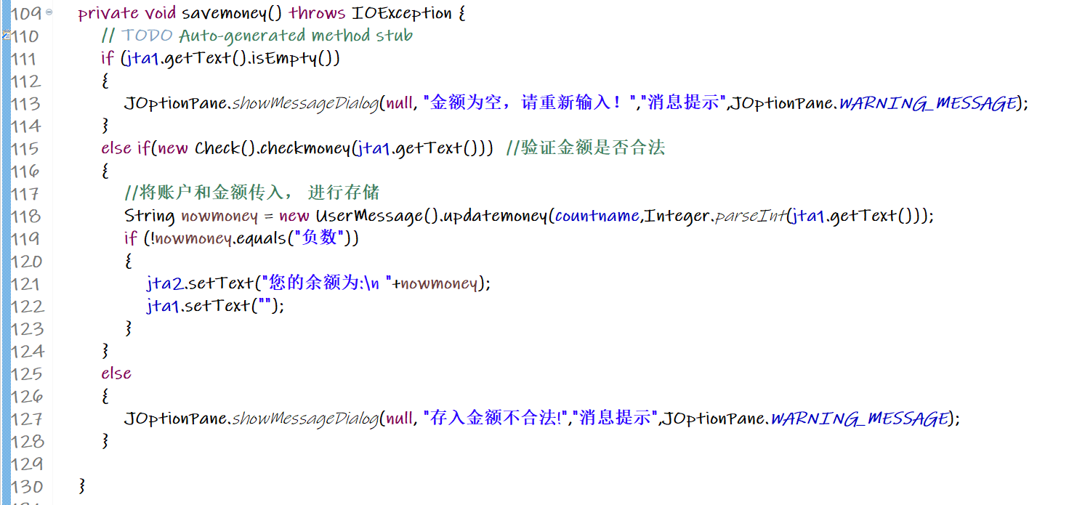
存款
Everyone has their own dreams, I am the same. But my dream is not a lawyer, not a doctor, not actors.
Everyone has their own dreams, I am the same. But my dream is not a lawyer, not a doctor, not actors.

Slide 28
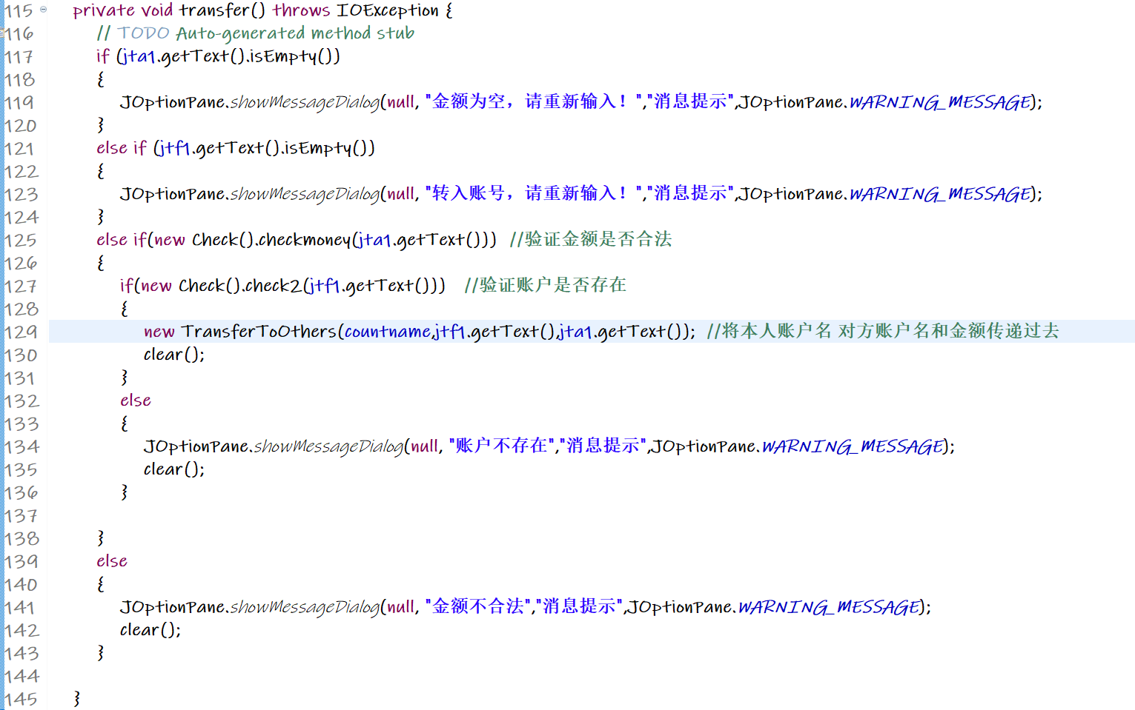
转账
Everyone has their own dreams, I am the same. But my dream is not a lawyer, not a doctor, not actors.
Everyone has their own dreams, I am the same. But my dream is not a lawyer, not a doctor, not actors.

Slide 29
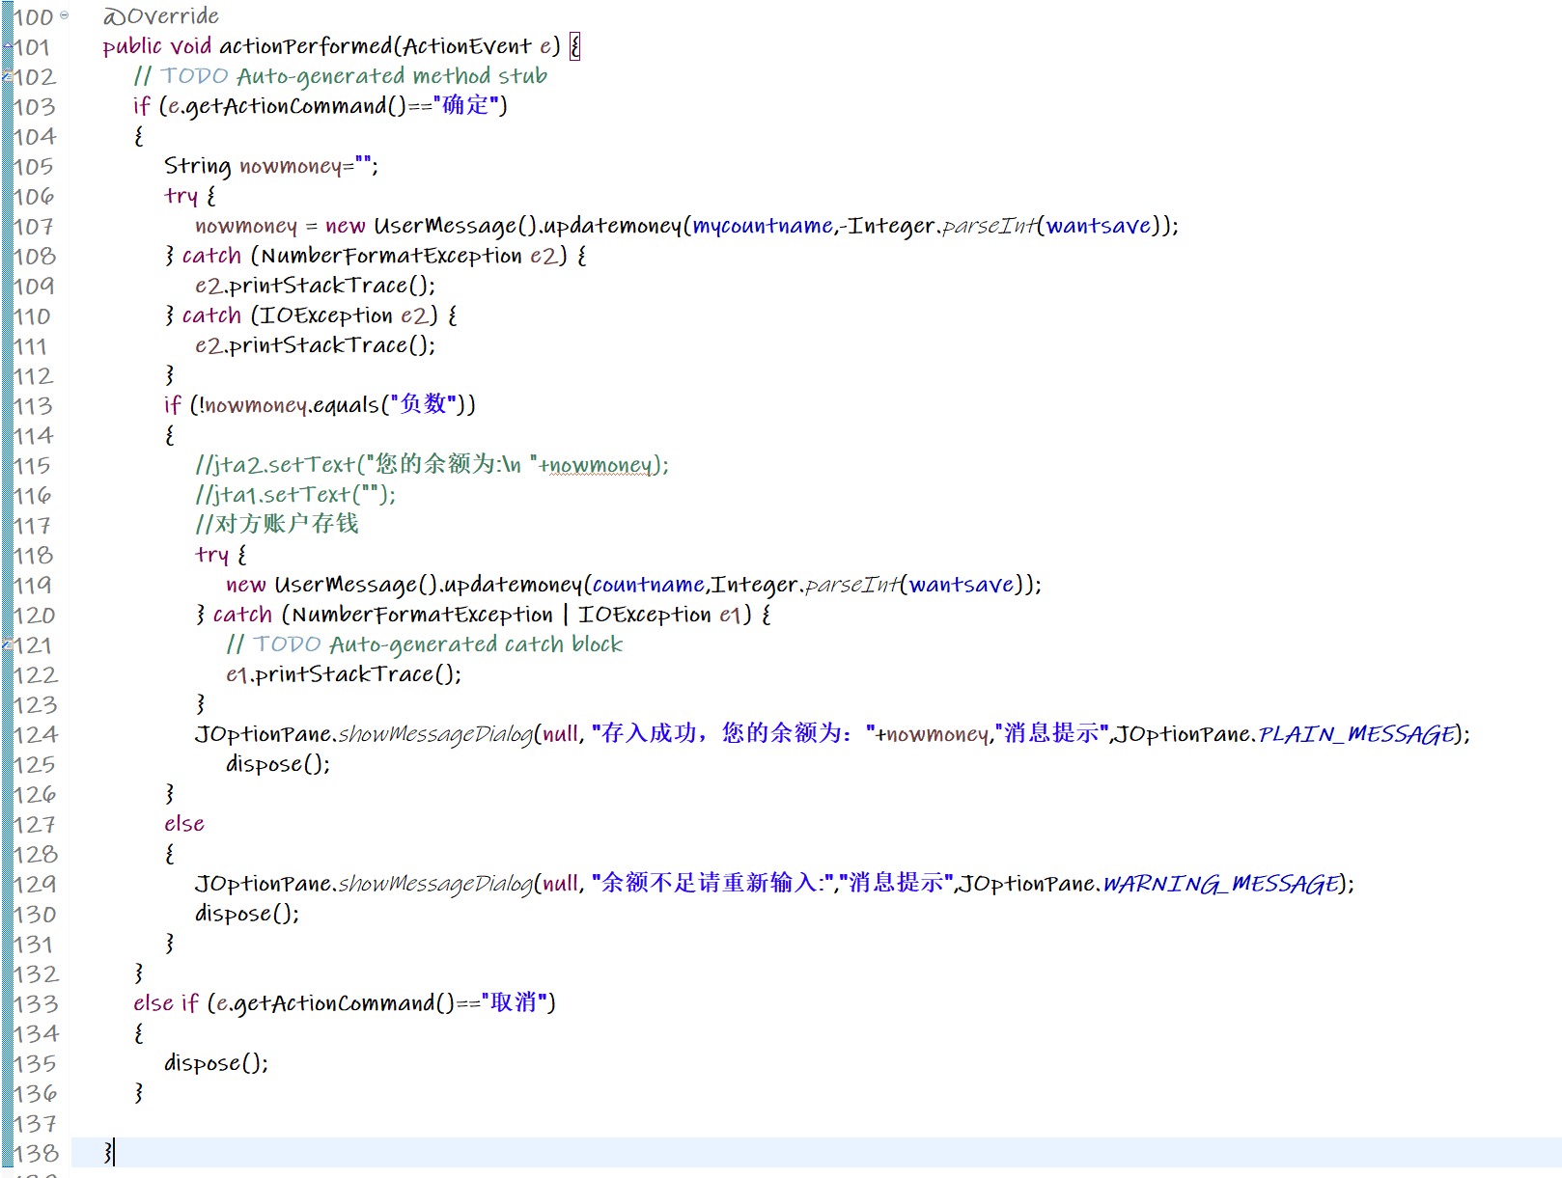
转账
Everyone has their own dreams, I am the same. But my dream is not a lawyer, not a doctor, not actors.
Everyone has their own dreams, I am the same. But my dream is not a lawyer, not a doctor, not actors.

Slide 30
WORKING
PLAN
挂失
（找回密码）
可视化
验证

Slide 31

正常挂失流程

Slide 32
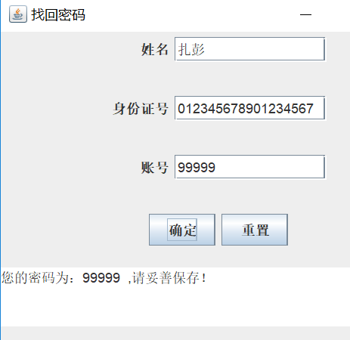
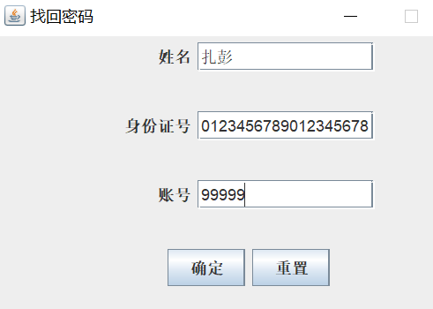
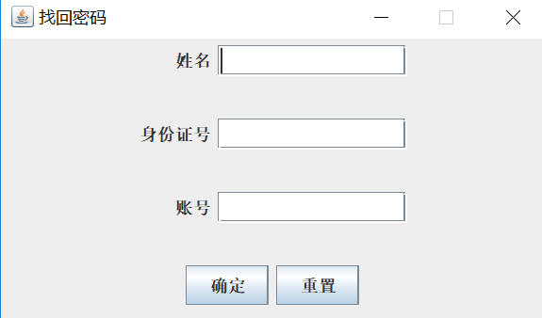
挂失（流程）
1.点击挂失
2.输入信息验证身份
3.获得密码

Slide 33
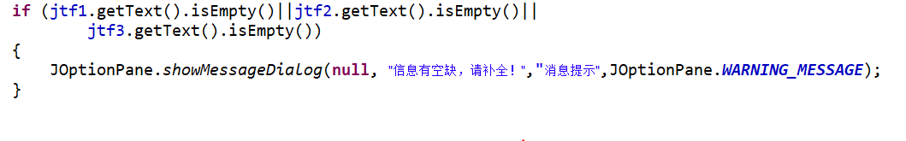
判断信息是否空缺
判断身份证号是否合法

Slide 34
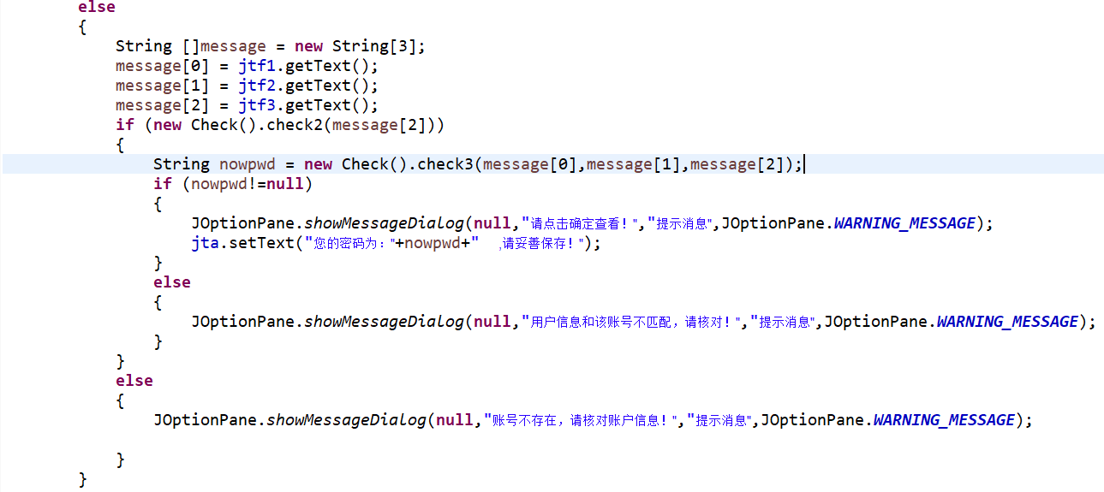
进行信息核对（与登陆前身份验证一致）

Slide 35
感谢聆听！

